Slide 1

Linker
Presented by Team HETI

Slide 2
What is Linker
Linker = LinkedIn +Tinder
Optimizing Recruiter Recruitee Connection
Replicating Tinder’s Success
Create Account Stylize Go
Profit Through Subscription

Slide 3
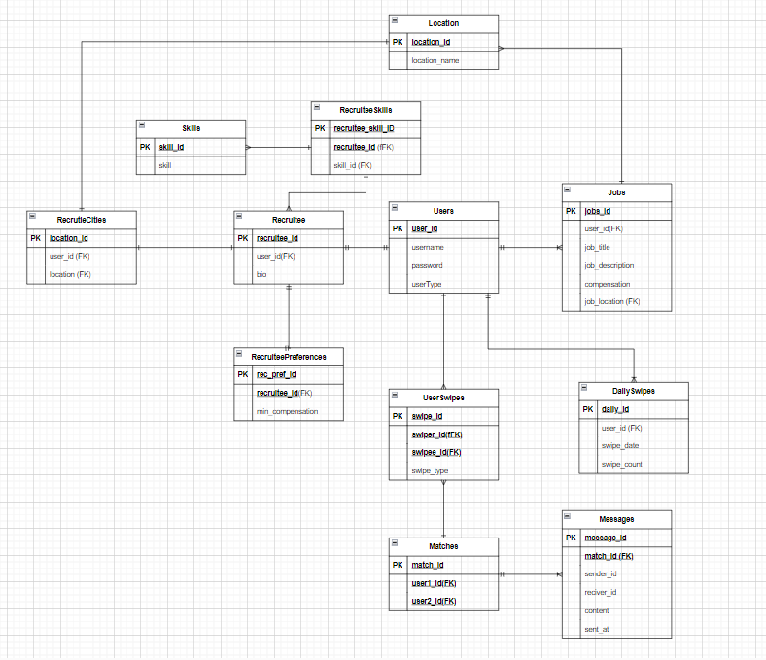
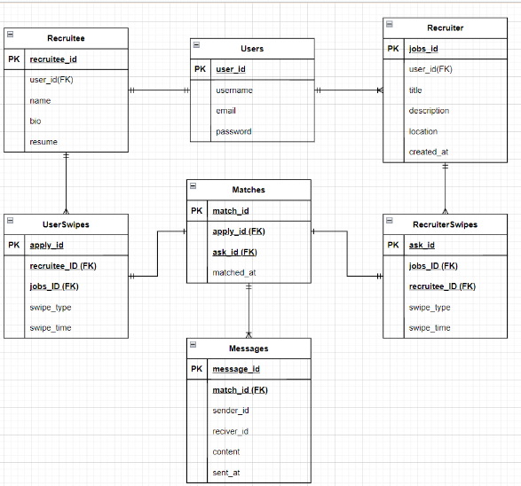
2NF Relational Model

Slide 5
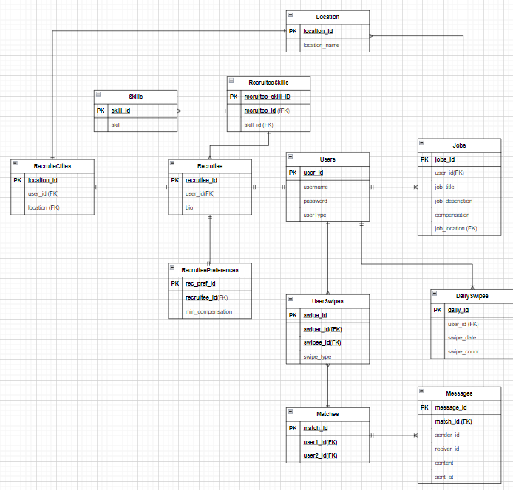

Slide 6
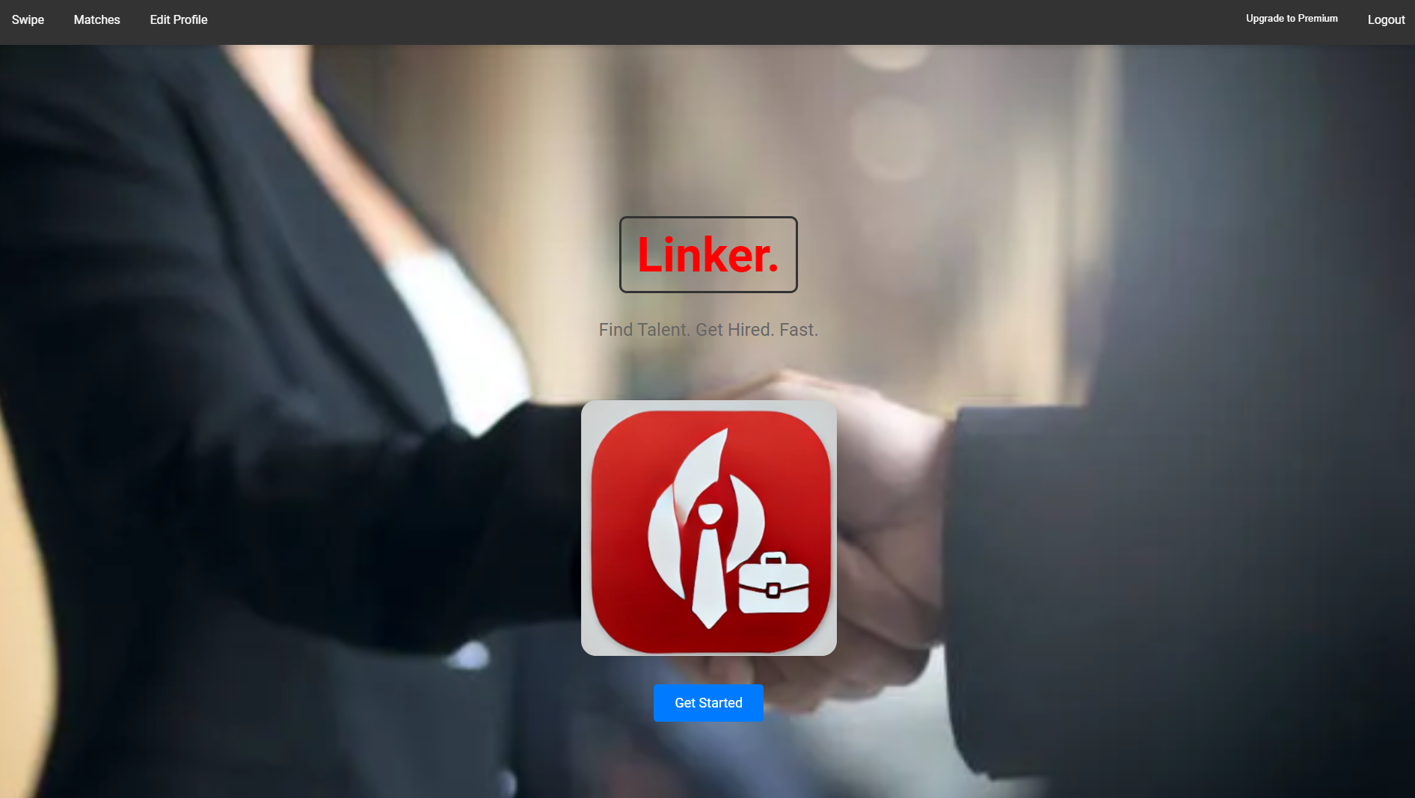
Landing Page Demo

Slide 7
Use Case (w/ user journey)
Job seeker opens the app
Chooses filter: salary/location
Swipes through recruiters based on preference
User can pay for Linker Premium for more swipes
Matches with recruiter to chat
Formal interview and lands job
Recruiter opens the app
Chooses filter: skills/location
Swipes through candidates based on preference
Recruiter can pay for Linker Premium for more swipes
Matches with recruitee to chat
Formal Interview and hires person

Slide 8
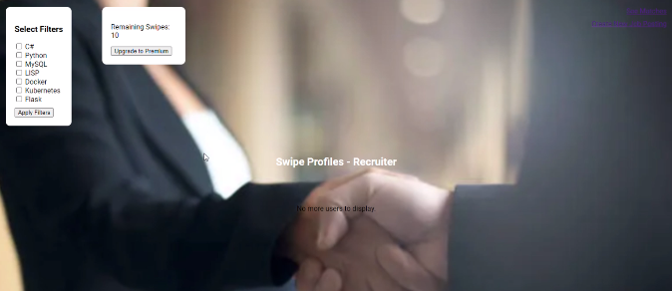
User Action Demo

Slide 9
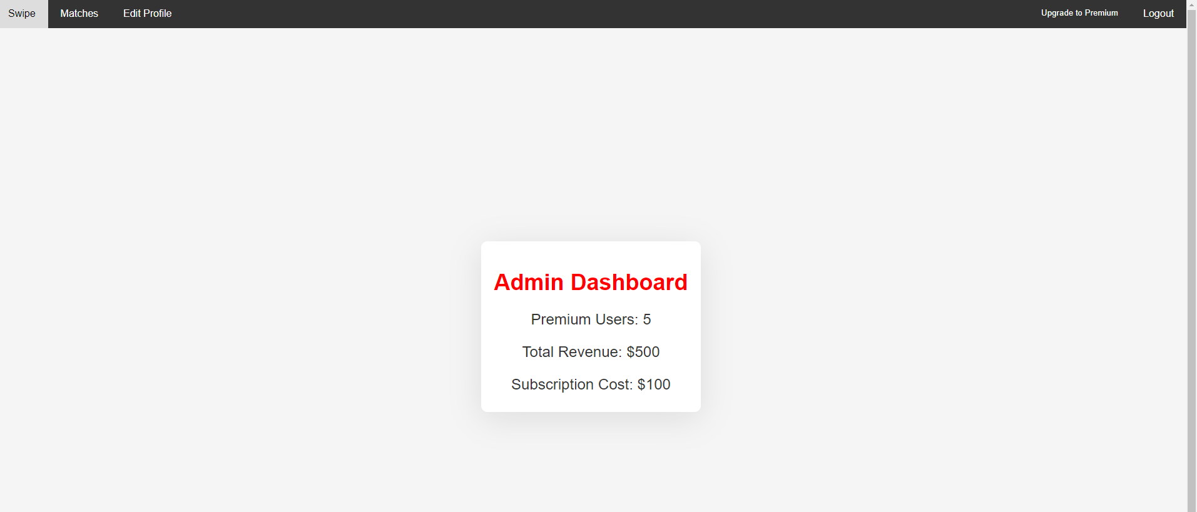
Reporting Demo

Slide 10
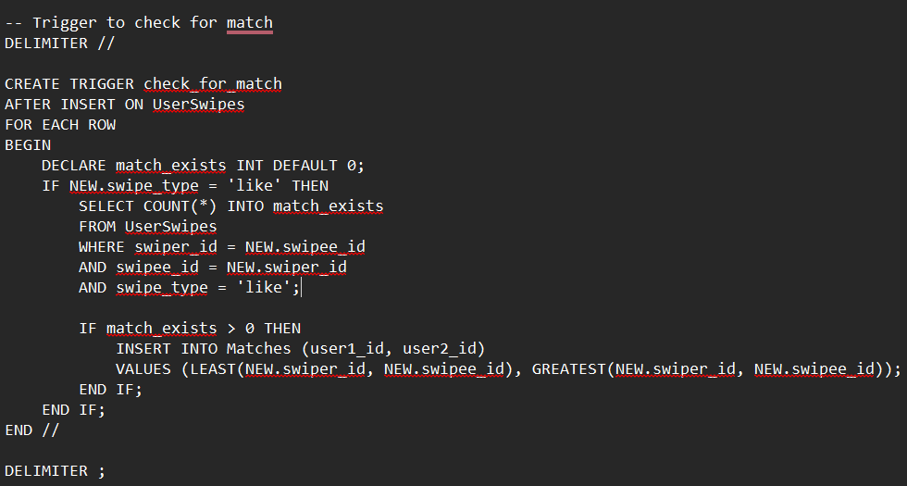
Stored Procedures
Trigger for a stored procedure:
-Used to update the match table

Slide 11
Extra Credit Features
Functional and Friendly UI

Slide 12
Job Delegation
Elly - Leader/manager, middle end structure
Tehseen - Database structure design
Ibrahim - Backend Development
Haris - Backend Development
Peijian - Front end react visual for the demo

Slide 13
Any Questions?
Thank you!

